Slide 1



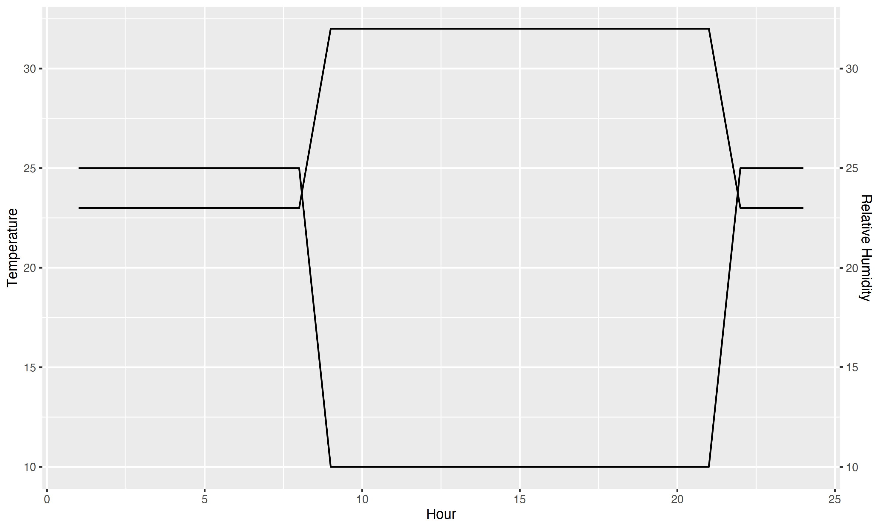
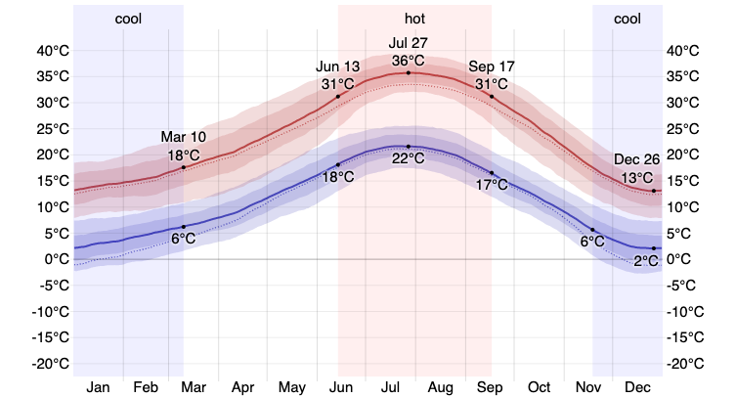
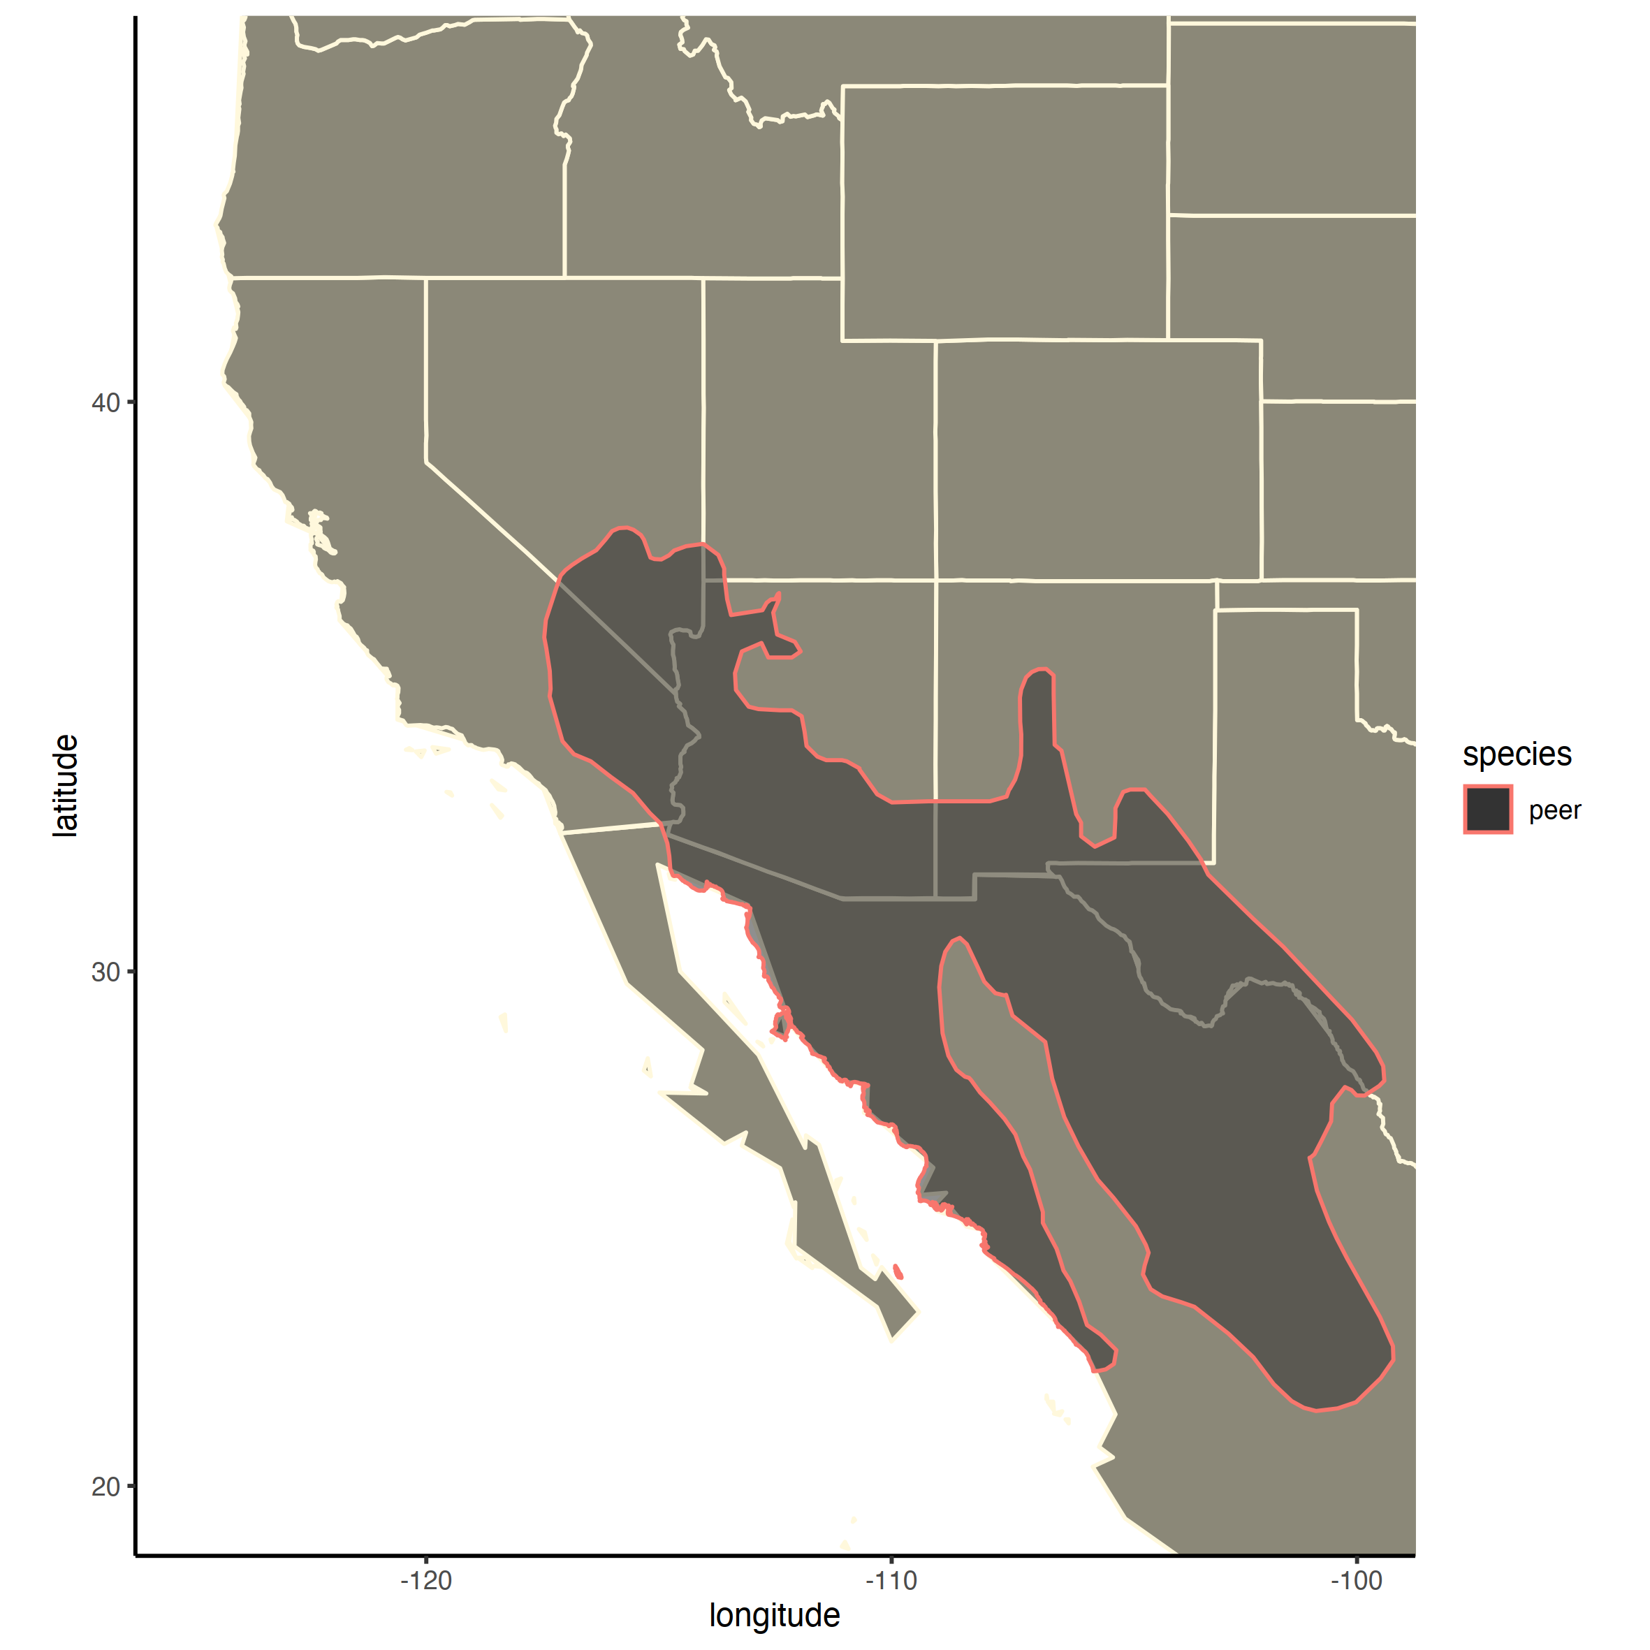




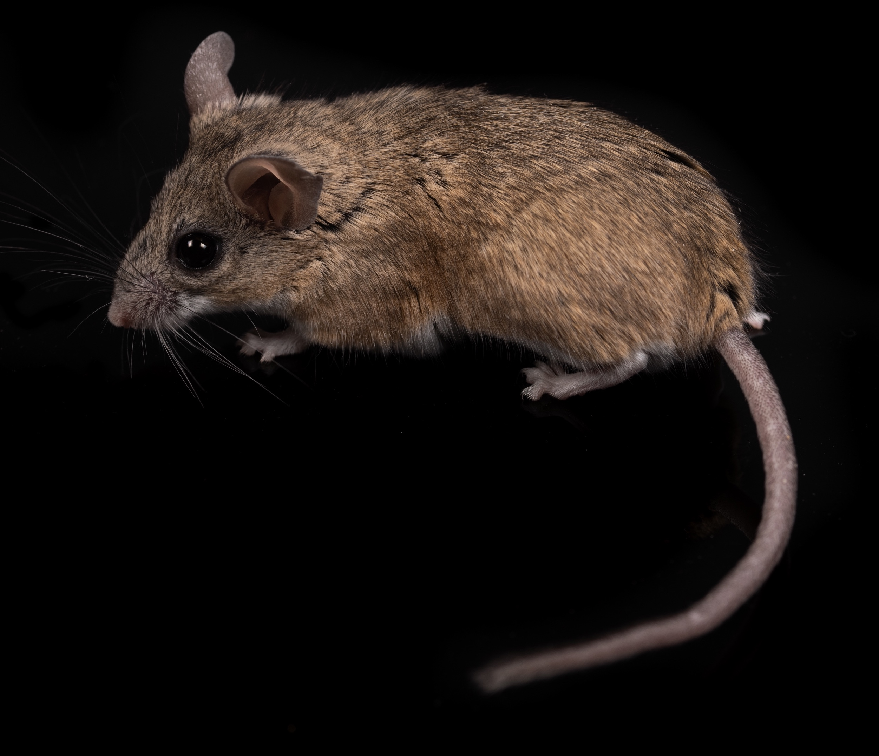




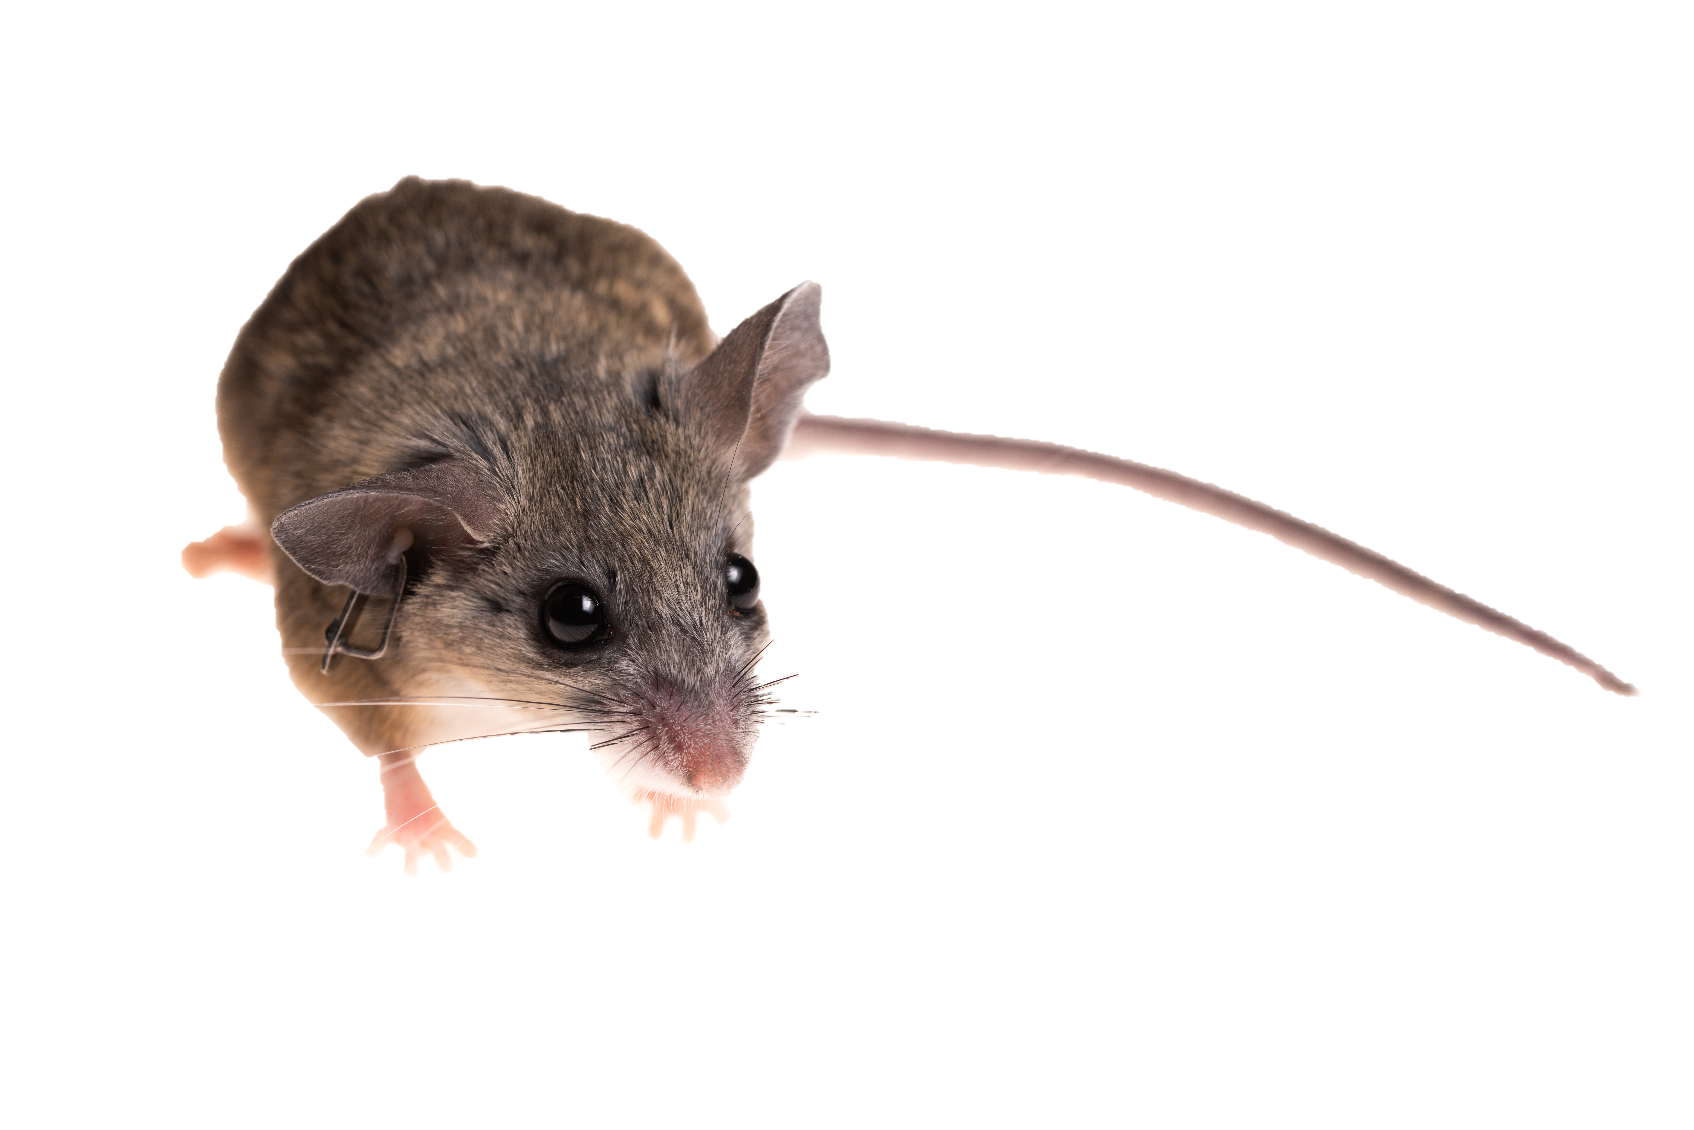
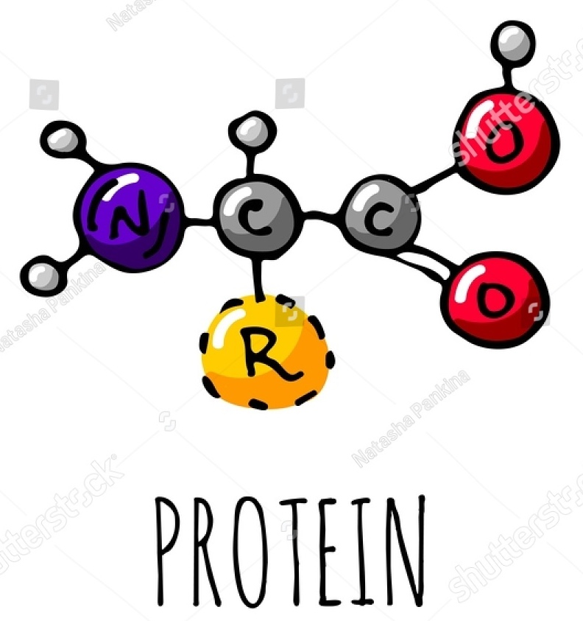
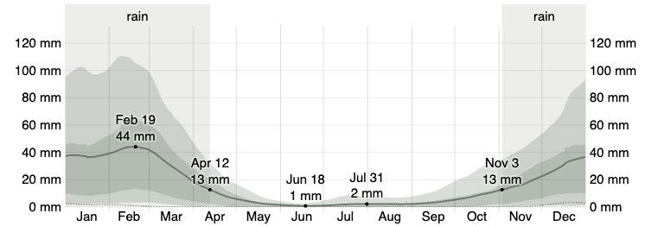
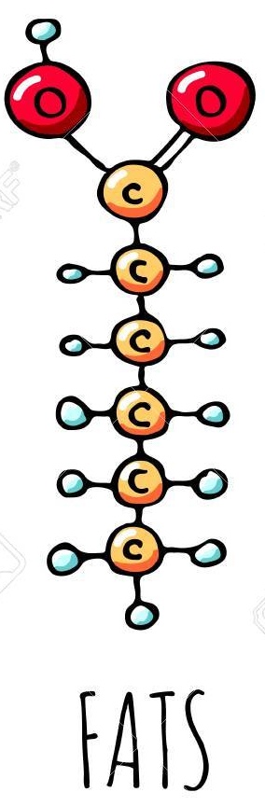
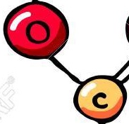

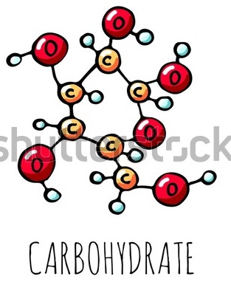

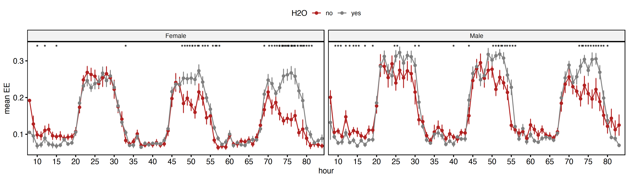
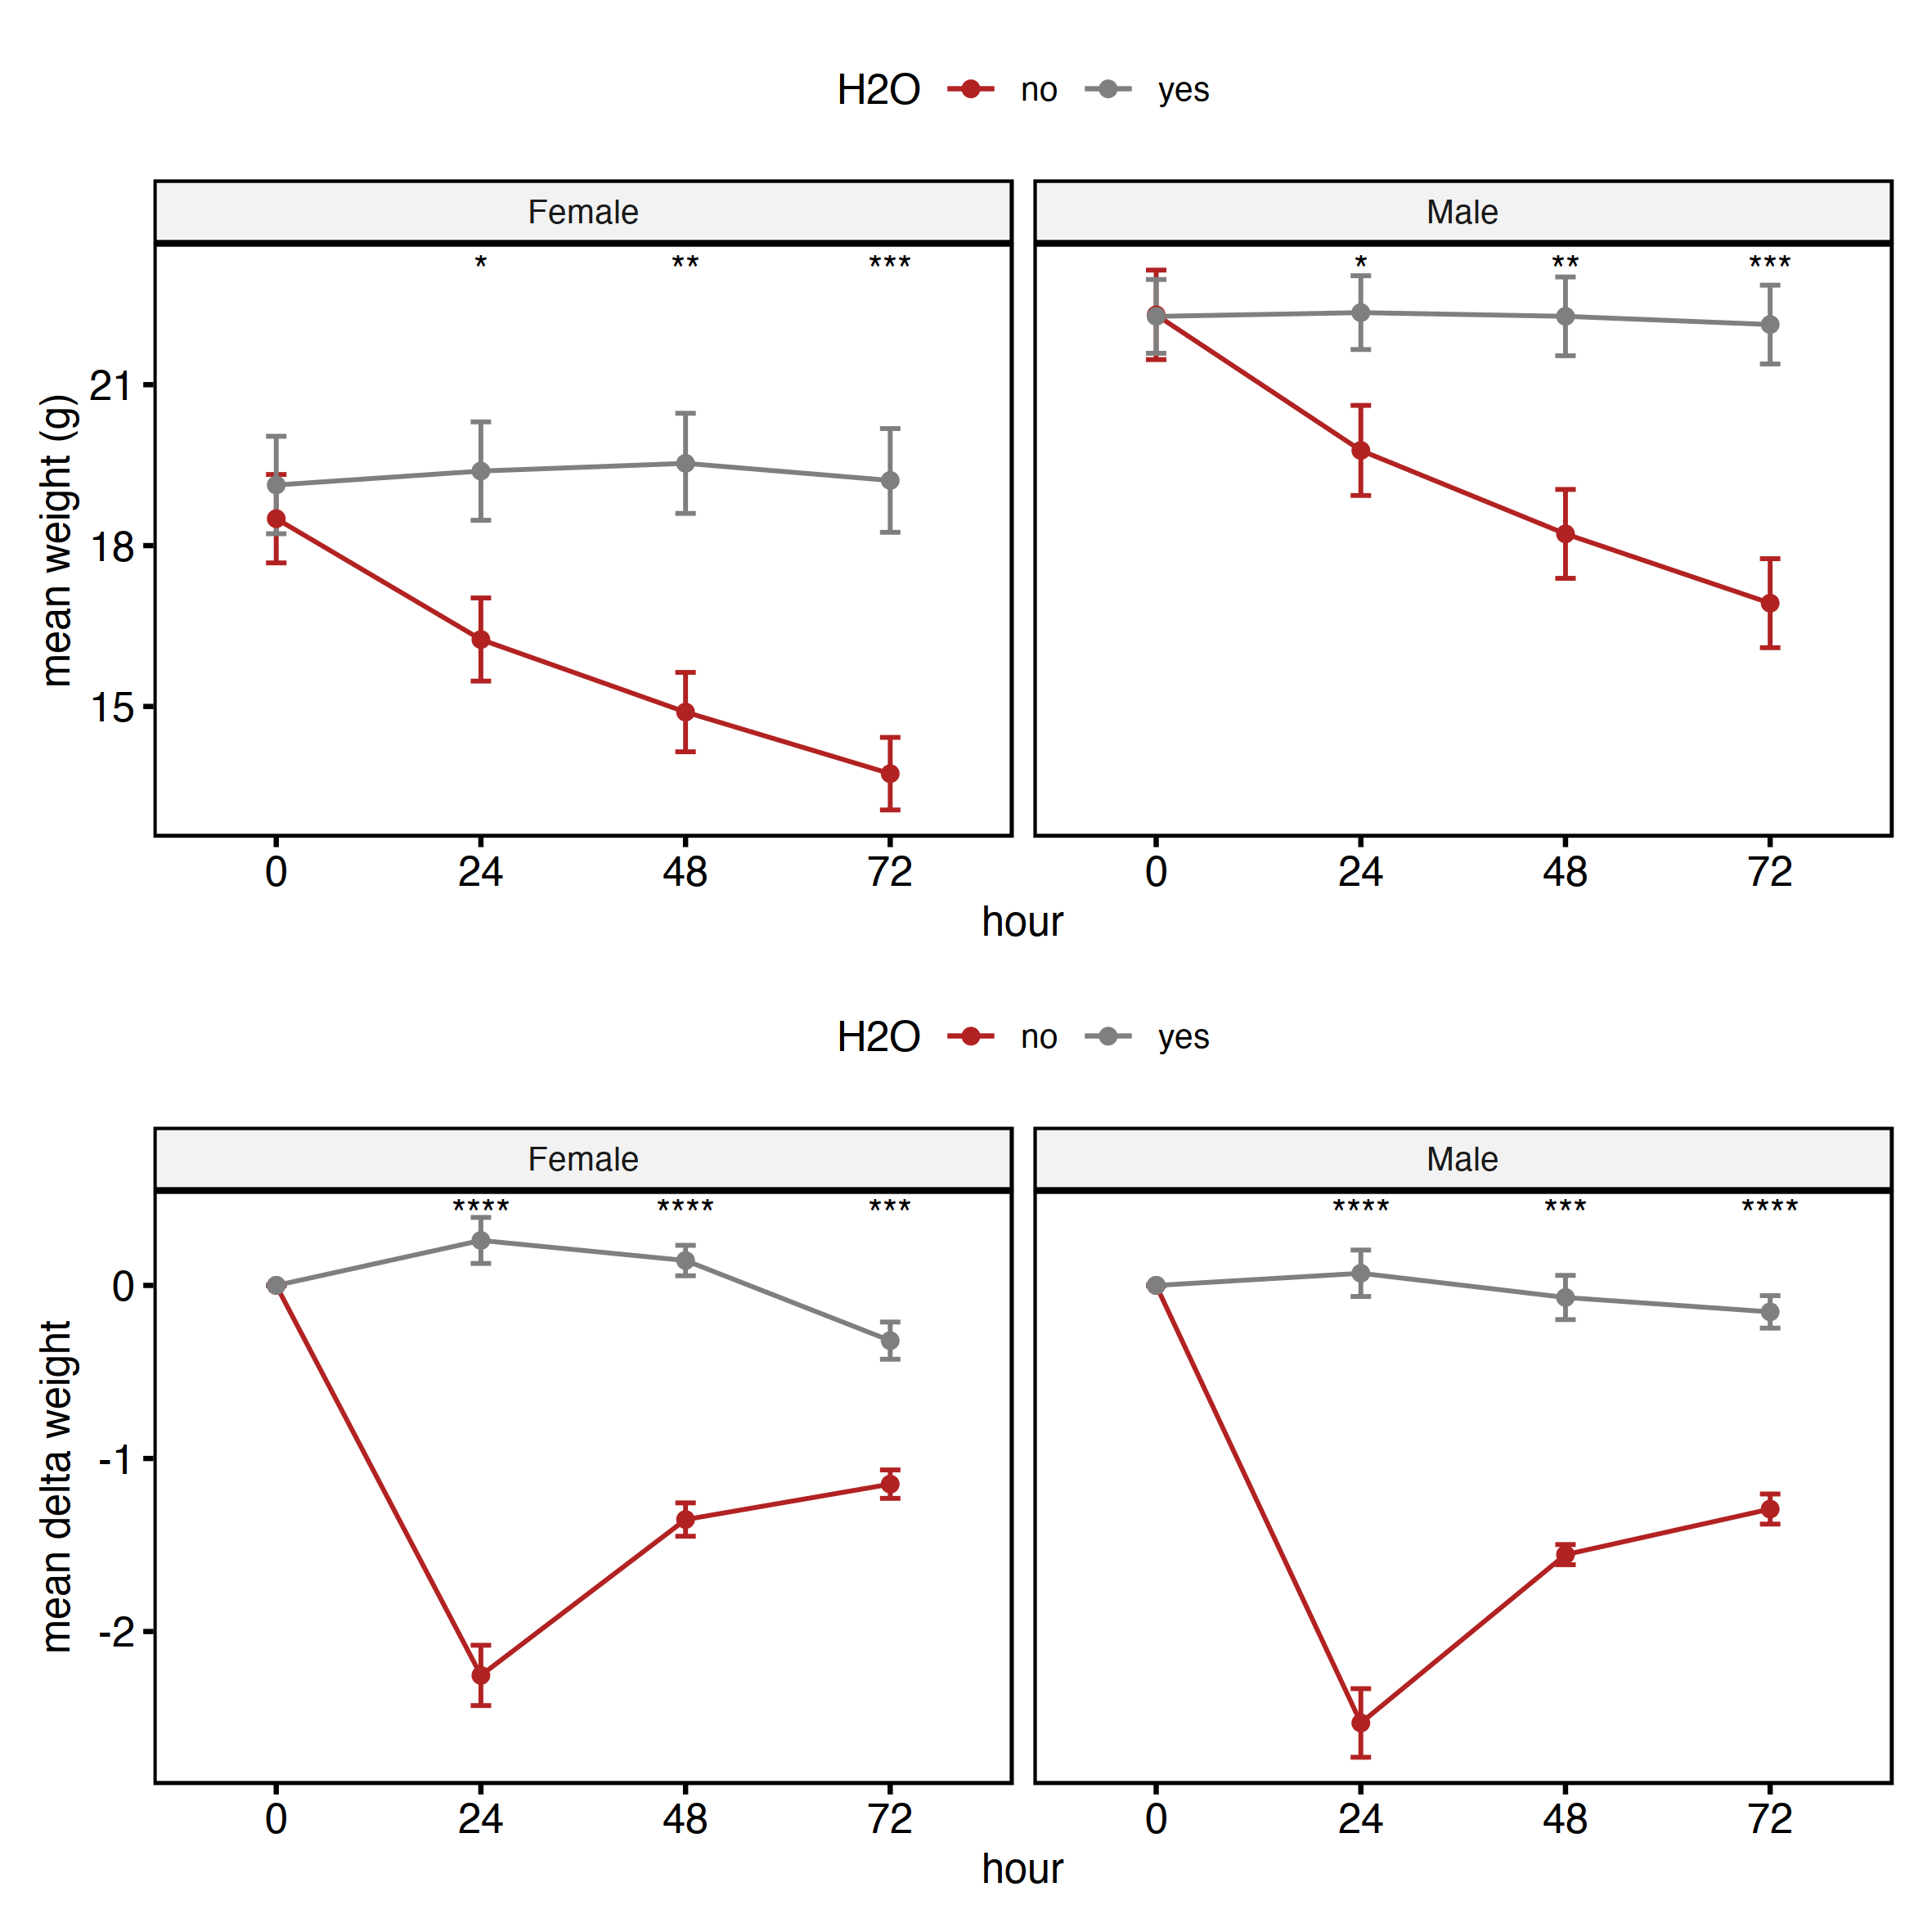
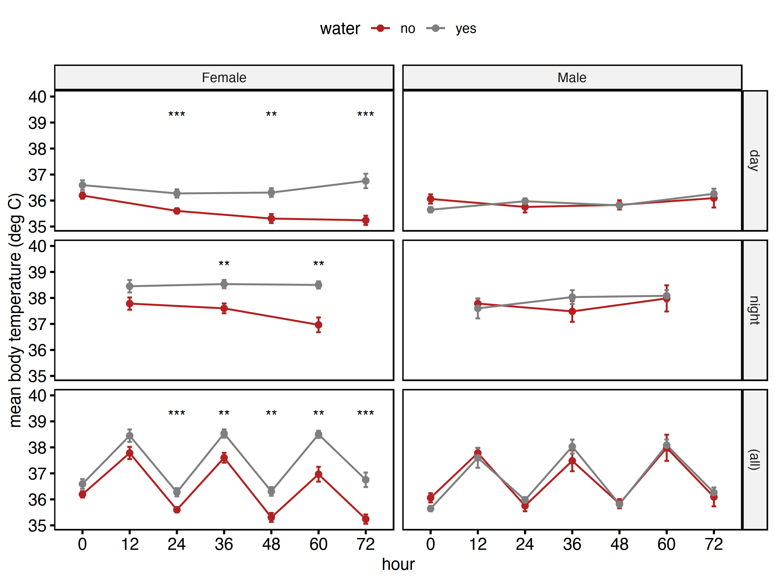

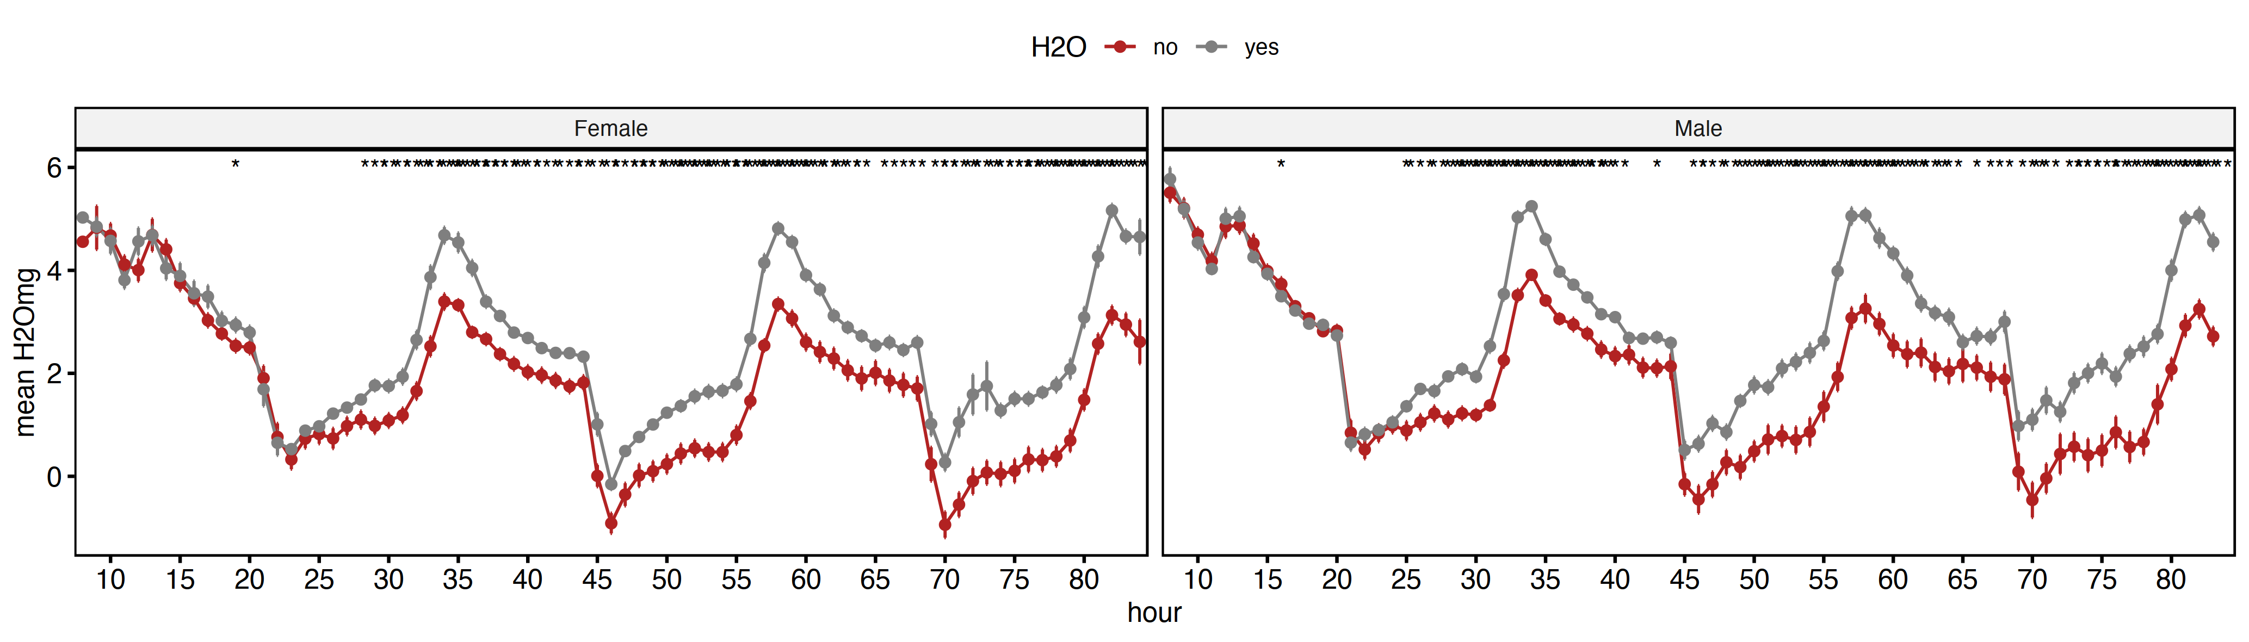



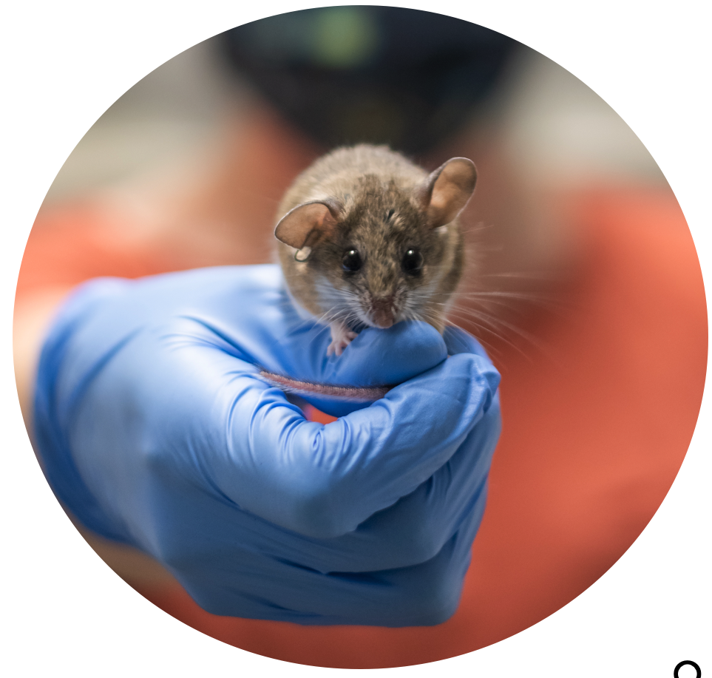

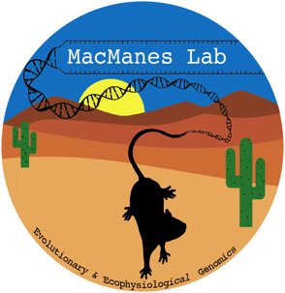
When the tap runs dry: The physiological effects of acute experimental dehydration in the desert adapted mouse
@DaniBlumstein
Danielle Blumstein and Matthew MacManes
Department of Molecular, Cellular, and Biomedical Sciences
📧Dani.Blumstein@unh.edu
Peromyscus eremicus
Methods
How are Peromyscus eremicus adapted to the desert?
Behavior
Physiology
Genomic
Why traits vary?
Evolutionary processes that drive variation in a trait
How traits vary?
Underlying molecular mechanisms that produces a trait
36 mice (18 males, 18 females)
72 hours of data collection in temperature cycling room
Weight every 24 hour
Body temperature every 12 hours
Real time metabolic rate and rate of water loss
Water ad libitum No water
Temperature
Dark
Relative Humidity
Dark
Light
Input
Output
O₂
Oxygen consumed(VO₂ )
H₂O
Water loss
mgH₂O
Indirect Calorimetry
Carbon Dioxide
produced
(VCO₂)
Photo: Adam Stuckert
Asses the amount of heat generated indirectly based on the amount of substrates used and byproducts generated.
© WeatherSpark.com
Lacher, T., Timm, R. & Álvarez-Castañeda, S.T. 2019. Peromyscus eremicus (amended version of 2018 assessment). The IUCN Red List of Threatened Species 2019: e.T16659A143641683. https://dx.doi.org/10.2305/IUCN.UK.2018-2.RLTS.T16659A143641683.en. Downloaded on 02 November 2021.
Results
Metabolic rate (kcal hr⁻¹)
Weight (g)
Body temperature (℃)
Dark phase
Metabolic rate decreases over the course of three days for mice without water.
Light phase
Rate of water loss (mg/hr)
Body temperature decreases in females that don’t have access to water.
Males maintained body temperature for both water treatments.
Mice without access to water lose weight over the course of the experiment.
Rate of water loss decreases over the course of three days for mice without water.
Water access
Discussion
Metabolic rate
Metabolic rate decreased during the dark phases.
A lower metabolic rate without water leads to less heat production.
Rate of water loss
Rate of water loss decreases.
Water could be decreasing because there is no water to be lost.
Reduced metabolism would lead to reduced water lost through respiration.
Mice are not using evaporative water to dissipate heat.
Weight loss
Body weight decreases.
Mice are experiencing dehydration-related weight loss.
Body temperature
♀: Daily torpor increases fitness as reproduction is primarily limited by access to resources.
♂: Maintained body temperature increases fitness as reproduction is competition based.
Acknowledgments:
Funded National Institute of Health National Institute of General Medical Sciences (R35 GM128843)
Animal care provided by the Animal Resources Office and veterinary care staff at the University of New Hampshire
Support from the MacManes and Rowe Lab
Adam Stuckert for detailed Peromyscus eremicus pictures
P. eremicus for having cool adaptations
Photo: Adam Stuckert
Notes:
Hi my name is Dani Blumstein. I’m a PhD student at the University of New Hampshire. My dissertation work is focused on the physiology and genomics of water management in a desert adapted species. The genus Peromyscus represent a unique framework to study physiological diversity as they have the widest distribution of any north American mammal. Among the members of the genus is the desert specialist, Peromyscus eremicus. Endemic to the southwest United States, P. eremicus display several adaptations to thrive in the water scarce environments.
The focus of this project is diet. In desert habitats, insects, vegetation, and seeds are the bulk of rodent diets. Due to the scarcity of water, seeds serve as both a source of food and water for rodents, so an optimal diet in the desert is the one that balances the rate of energy gain with nutritional factor, and metabolic water
We have set up a long term metabolic system that measured mg of water, co2 produced, and oxygen consumed of mice in a desert simulated chamber. With these measurements we are able to calculated metabolic response variables such as the respatory quotient and energy expenditure. Here we have manipulated the fat content in diet.
The first notable result is that P. eremicus showed a circadian cycle for each metabolic response variable in phase with photoperiod and room temperature. This shows that phenotyping through environmental transitions can help us better understand the physiological responses of organisms to dynamic environments.
The second notable result is that diets produces similar EE during the distinct time points but different amounts of total evaporative water loss. This is interesting because a change in EE can lead to increased respiratory water loss however we don’t see a statically different change in EE between the two diets but we do see an increase in evaporative water loss, with the most water being lost during the day when the temperature is at its hottest for mice on the lower fat diet.
For those interested, you can scan the QR code in the results section to see more graphs and data that are related to this research but not presented on this poster.
I’ve choosing to take a top down approach to my PhD where I know that we want to understand the physiology of dehydration. there are a few clear experiments to do such as diet and dehydration experiments in a colony setting and then contrasting that to field studies but to be more specific, I’ve chosen 5 tissues all that drive water use and absorption or filter toxins from the body and hopefully looking at these tissues under specific conditions will help us find some interesting genes and provide insight into how these animals live in such harsh environments.

